Slide 1

The Contribution of Orthographic Learning to Skilled Word Reading
Brooke Moore
Notes:
My name is Brooke Moore and the title of my research paper is The Contribution of Orthographic Learning to Skilled Word Reading.

Slide 2
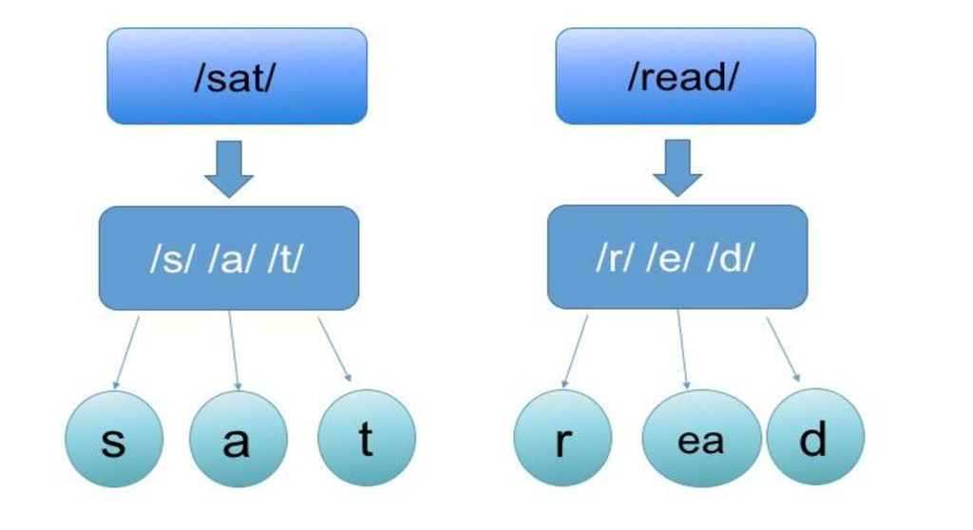
Orthographic Mapping
Notes:
For the last few years I have had a growing interest in orthographic mapping and how the research on how we store words in memory can help shape the way we teach kids not just to know how to figure out unfamiliar words, but how to learn those words so that they remember them each time they encounter them. People like David Kilpatrick have been instrumental in highlighting years of research on orthographic learning, and in particular, the research on orthographic mapping. It is exciting that this work is making its way into the hands of classroom teachers and reading specialists. Initially, I had planned to do my research specifically on orthographic mapping, but then decided to broaden the topic to orthographic learning.

Slide 3

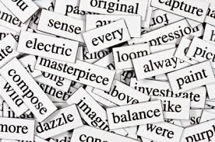
Orthographic Learning
The process of learning to read and remember specific, individual words, resulting in complete and accurate representations of words
Involves the bonding of a word’s spelling, pronunciation and meaning in the reader’s memory
Without orthographic learning, a reader has to decode or otherwise identify specific words each and every time they encounter them, negatively affecting both fluency and comprehension
Notes:
→Orthographic learning can be defined as the process of learning to read and remember specific, individual words, resulting in complete and accurate orthographic representations of words.
→It involves the bonding of a word’s spelling, pronunciation and meaning in the reader’s memory.
→Orthographic learning is important because without it, a reader has to decode or otherwise identify specific words each and every time they encounter them, negatively affecting both fluency and comprehension.

Slide 4
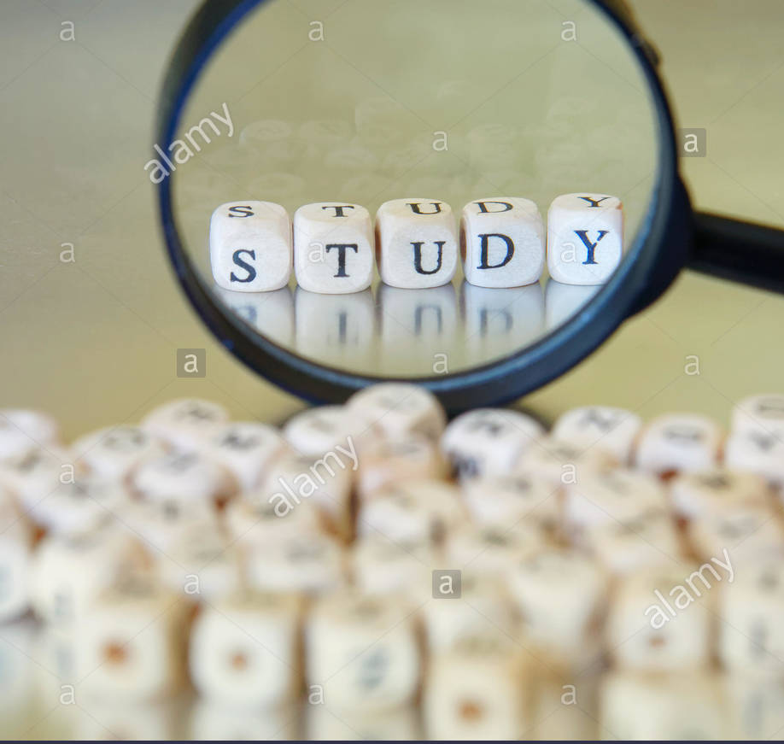
Purpose of this Research
Goal: research the factors and learning conditions associated with orthographic learning
Primary question: how do words transition from being unfamiliar, requiring identification strategies, to familiar and able to be read instantly from memory?
Strategy: explore quasi-experimental studies published in the last ten years conducted with beginning or struggling readers in the early elementary grades
Notes:
→My goal in writing this literature review was to research the factors and learning conditions associated with orthographic learning.
→The primary question I sought to answer was how words transition from being unfamiliar, requiring identification strategies, to familiar, where they can be read instantly from memory. →The studies I chose to review were all published in the last ten years and focused on beginning or struggling readers in the early elementary grades.

Slide 5
Factors and Learning Conditions Explored
Word specific factors
phonology
meaning (semantics/vocab)
grapheme-phoneme regularity
grammatical class (syntax)
spelling
Learning conditions
sentence/story context
no context (e.g., flash cards)
Role of individual differences
language skills
alphabetic knowledge
decoding skill levels
Notes:
→Word specific factors I explored included phonology, semantics/vocabulary, grapheme-phoneme regularity, grammatical class or syntax, and spelling.
→The learning conditions I researched focused on the difference between teaching words in context or in isolation.
→Individual differences that I looked at included language skills, alphabetic knowledge and decoding levels.

Slide 6
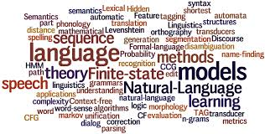
What word specific factors were associated with orthographic learning?
Pre-exposure to word phonology and general skill with phonemic awareness
Teaching words with consistent grapheme-phoneme regularities
Knowledge of word-specific vocabulary but not generalized vocabulary knowledge
Teaching words categorized as content words but not function words
Knowledge of word spelling/orthography
Notes:
The findings related to word specific factors showed that:
→ orthographic learning was enhanced by pre-exposure to a word’s phonology. In other words, introduce the word orally first, before showing and teaching its spelling.
→ words with consistent grapheme-phoneme correspondences were more easily learned than irregular words
→ knowledge of word-specific vocabulary enhanced word learning but not generalized vocabulary knowledge
→ a word’s grammatical class makes a difference in one’s ability to learn specific words. Function words that require context for meaning and are often irregularly spelled pose particular problems for orthographic learning, while content words such as nouns are more easily learned, even if they are irregularly spelled
→ Learning by spelling the words improves both the strength and quality of orthographic representations in comparison to learning by reading the word only

Slide 7
What specific learning conditions were associated with orthographic learning?
Teaching words in isolation results in stronger orthographic representations, but only for readers with age-appropriate decoding skills
Teaching words in sentence/story context helps with initial reading of words but not necessarily orthographic learning (mixed results)
Teaching words in sentence/story context does help readers learn semantic and syntactic features of words
Notes:
Here are the findings related to specific learning conditions:
→ target words taught in isolation (that is, without the context of a sentence or story) result in stronger orthographic images, but only for readers with age appropriate decoding skills
→ teaching new words in the context of sentences or stories helps children read the words initially, but doesn’t necessarily result in more permanent word learning (studies report conflicting results)
→ words taught in the context of sentences or stories help readers learn the semantic and syntactic elements of words but results in weaker orthographic representations

Slide 8

How do individual differences affect orthographic learning?
Individual alphabetic skills and decoding ability level determine the ease of specific word learning
Pre-existing orthographic knowledge also contributes to stronger orthographic representations of words
Mixed results on the contribution of individual vocabulary skills
  Word-specific oral vocabulary benefits word learning
  Generalized vocabulary knowledge is not necessarily associated with increased orthographic learning
Notes:
Here are the findings related to the role of individual differences
→ Individual alphabetic skills and decoding ability level determines the ease of specific word learning
→ An individuals’s pre-existing orthographic knowledge contributes to stronger orthographic representations of words
→ I found mixed results on the contribution of individual vocabulary skills. Overall, I found that
Oral vocabulary benefits world learning
Generalized vocabulary knowledge is not necessarily associated with increased orthographic learning

Slide 9
Implications for how we teach words
Educators should determine specific goals when teaching words in order to focus instruction on targeted word elements (e.g., phonology, orthography, semantics, syntax)
Not all words are equal when it comes to ease of orthographic learning. Consider that regular words and more concrete words (e.g. nouns) are more easily learned
Students’ language, alphabetic and decoding skills impact their ability to learn words. Partial alphabetic readers are not good candidates for learning irregular words or function words; instruction time may be better spent strengthening PA, letter sound knowledge and blending skills
Notes:
These studies provide important implications for how educators teach words
→ First, educators should determine specific goals when teaching words, in order to focus on targeted word elements (for example, whether it’s more important to focus on phonology and orthography, as it might be for the youngest readers, or semantics and syntax, for older or more advanced readers)
→ Second, not all words are learned with equal effort. Words that have regular grapheme-phoneme correspondence and that have more concrete meaning (such as content words) are more easily learned than irregular or abstract words
→ Third, students’ language, alphabetic and decoding skills impact their ability to learn words. Partial alphabetic readers are not good candidates for learning irregular words or function words; instead, instruction time may be better spent strengthening their phonemic awareness skills, letter-sound correspondence knowledge, and blending skills

Slide 10
Implications (continued)
Introducing words orally before showing the spelling benefits word-specific orthographic learning
Some studies indicate that teaching word specific vocabulary improves word learning
Include activities or exercises that require children to practice spelling target words (such as mapping with sound-spelling boxes) to strengthen orthographic representations
Notes:
→ Some more specific implications regarding instructional techniques include:
Introducing words orally before showing the spelling (highlighting the importance of word phonology)
→ Some studies indicate that teaching word specific vocabulary improves word learning
→ Include activities or exercises that require children to practice spelling target words (such as mapping with sound-spelling boxes) to strengthen their orthographic representations

Slide 11

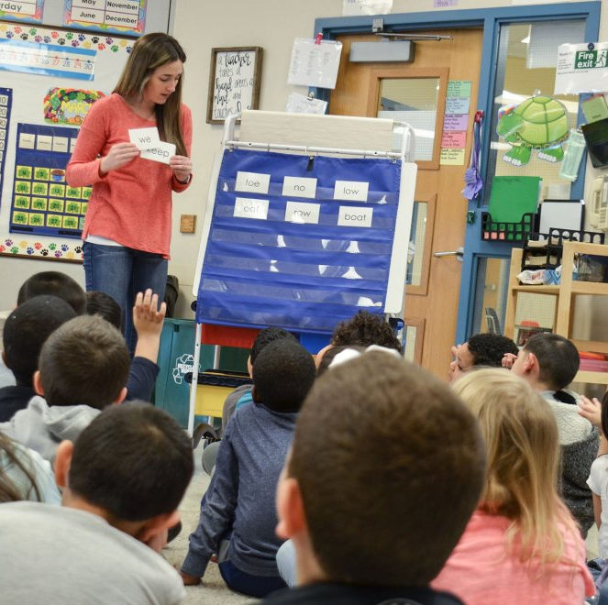

Key take-aways
Orthographic learning is complex! When planning word-specific instruction or intervention, remember:
  The words we choose to teach matter
  The way we teach those words matter
  The differences in our students’ pre-existing knowledge and skills matter
Notes:
Here are the key take-aways from my research:
→ The process of orthographic learning is incredibly complex! When planning word-specific instruction or intervention, remember:
The words we choose for teaching matter
The *way* we teach those words matter
The differences in our students’ pre-existing knowledge and skills matter
Thank you for viewing my presentation and I wish the best of luck to everyone!

